Slide 1
A NOVEL CONTROL METHOD OF DC-DC CONVERTERS
Dr.M.Nandakumar
Professor
Department of Electrical engineering
Govt. Engineering College
Thrissur

Slide 2
Outline
Introduction
DC-DC converter topologies
Buck converter
Closed loop control of buck converter using PI controller
One cycle control
Buck converter using OCC
Boost converter
Boost converter using PI controller
Boost converter using OCC
One Cycle Control of Buck Boost converter
Performance comparison of PI and OCC controller
conclusion

Slide 3
Introduction
DC-DC converters are subjected to variable input/ variable output conditions
Regulation of converter operation is an essential requirement
Closed loop controller is used for the regulation of out put voltage
1. Line Regulation
2. Load regulation

Slide 4
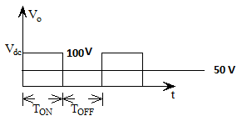
DC-DC conversion techniques –an introduction

Slide 5
DC- DC Converter Topologies
Buck converter or step - down converter
Boost converter or step - up converter
Buck-Boost converter or step-down/up converter
Cuk converter
Full Bridge converter
Only step-down and step-up are the basic converter topologies
Both buck-boost and cuk converters are combination of these basic topologies
Full bridge converter is derived from step-down converter

Slide 6
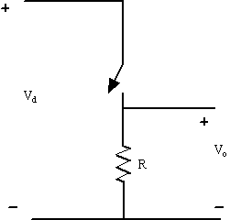
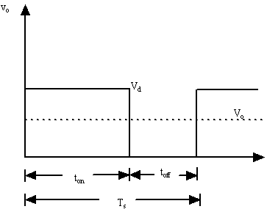
Switch-mode dc-dc converter

Slide 7
Drawbacks and modifications of the circuit
Drawbacks
In practical circuits, load will be inductive (even for resistive load due to stray inductance) leading to dissipate or absorb the inductive energy which may destroy the switch
Output voltage fluctuates between 0 and V_{d}
Modifications
Problem of stored inductive energy is overcome using freewheeling diode
Output voltage fluctuation are very much diminished using Low pass Filter

Slide 8
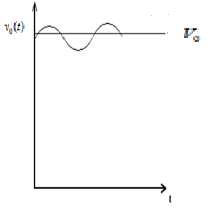
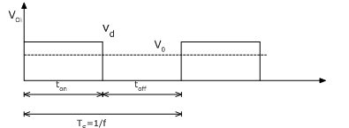
Buck converter (Step-down converter)

Slide 9
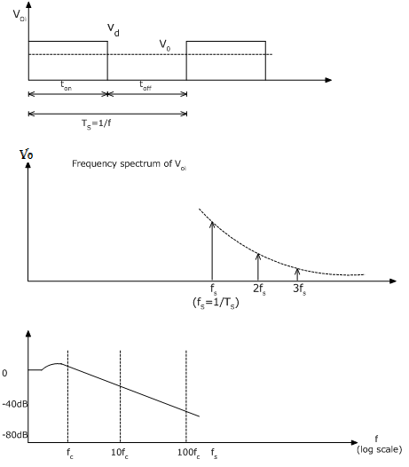
Sep-down dc-dc converter

Slide 10
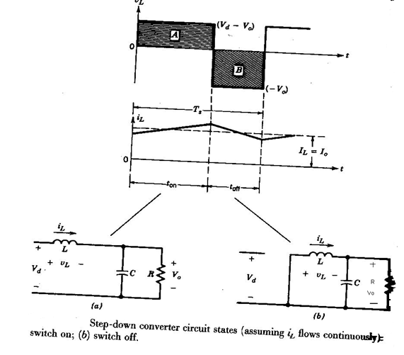
Step-down converter circuit states (Continuous Conduction Mode)

Slide 11
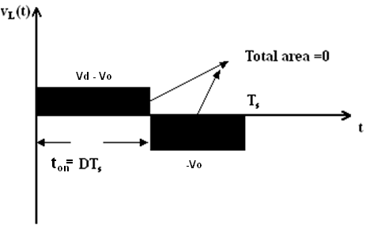
Volt-sec balance (cont.)
Under steady state operation the integral of the inductor voltage v_{L} over one time period must be zero

Slide 12
Buck converter (Step-down converter) in CCM
In Continuous Conduction Mode (CCM), neglecting power losses associated with all circuit elements, the input power P_{d} is equal to output power P_{o}
I_{o} is the average output current and I_{d} is the average input current
Hence in CCM step – down converter is equivalent to a dc transformer (step down)

Slide 13
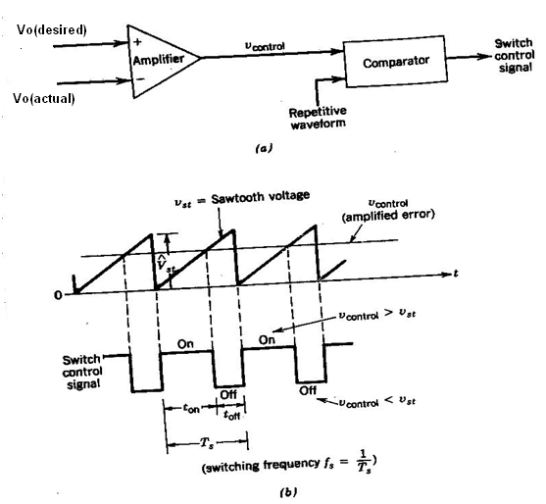
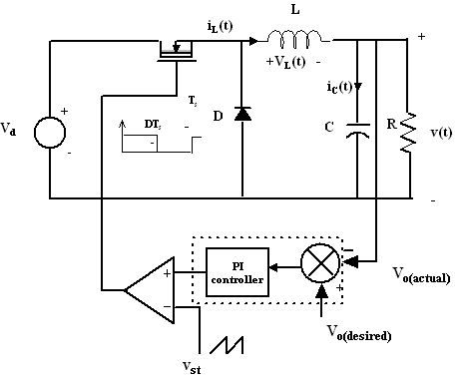
Closed loop control of buck converter

Slide 14
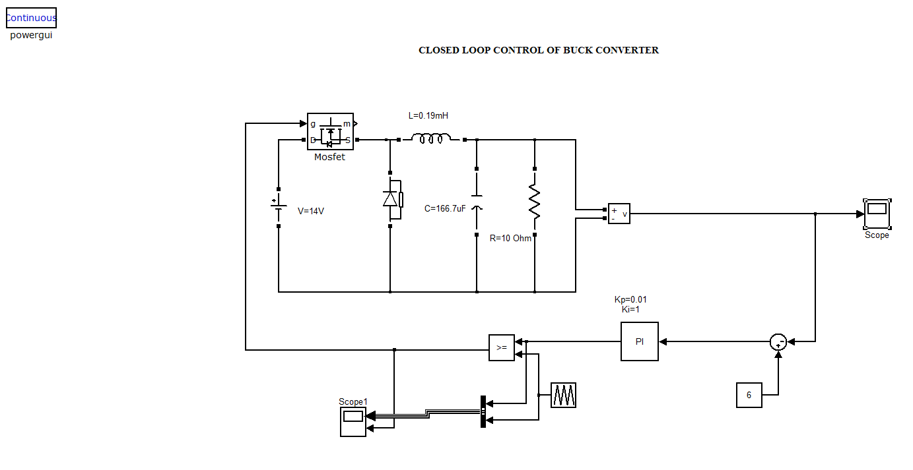
Closed loop control of Buck Converter (with fixed input)

Slide 15
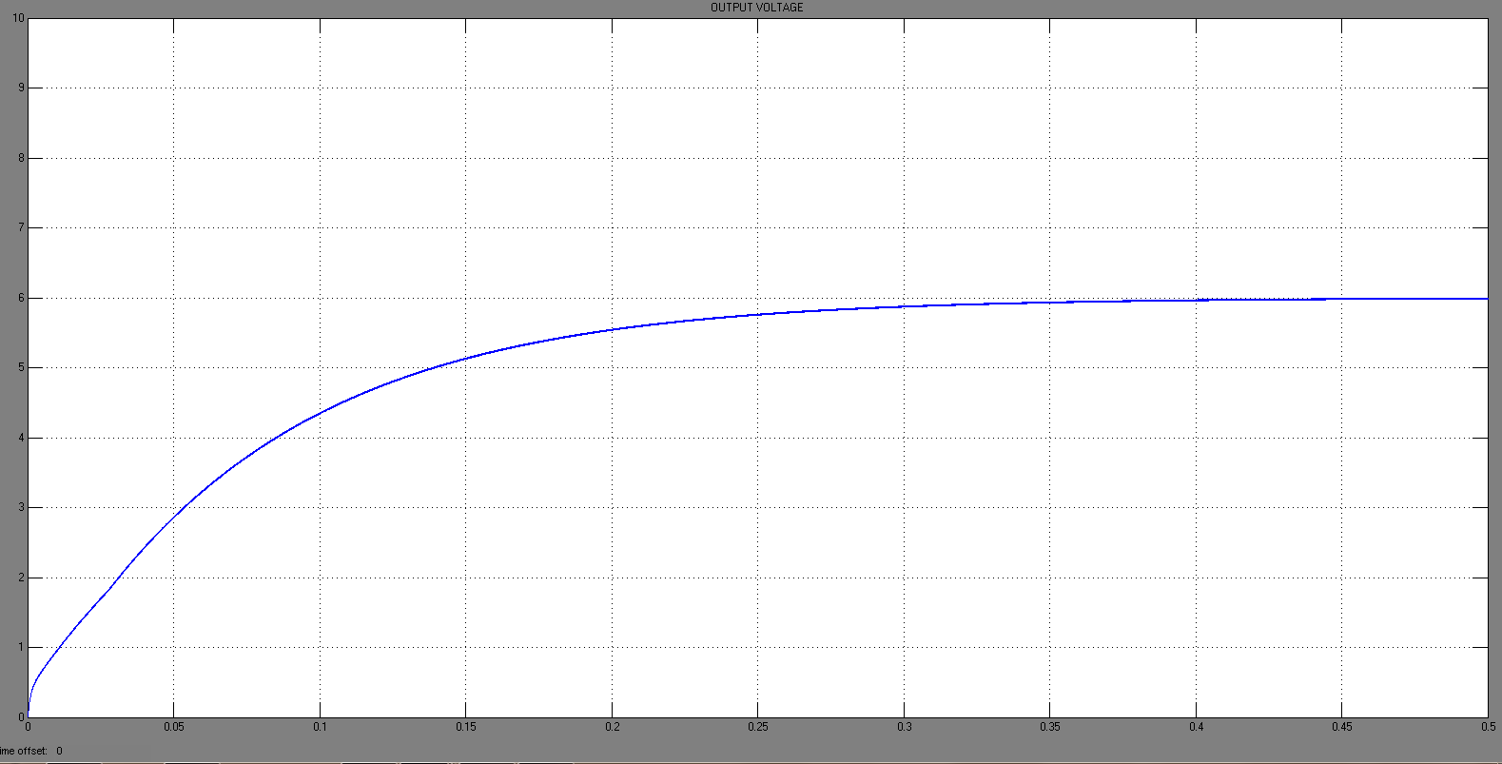
Closed loop control of Buck Converter (with fixed input)-output voltage

Slide 16
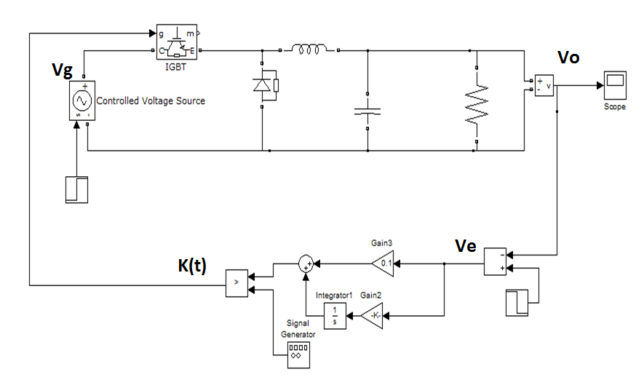
Buck converter using PI controller

Slide 17
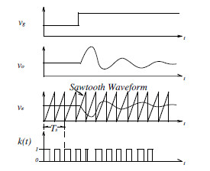
Transient performance of PI controller

Slide 18
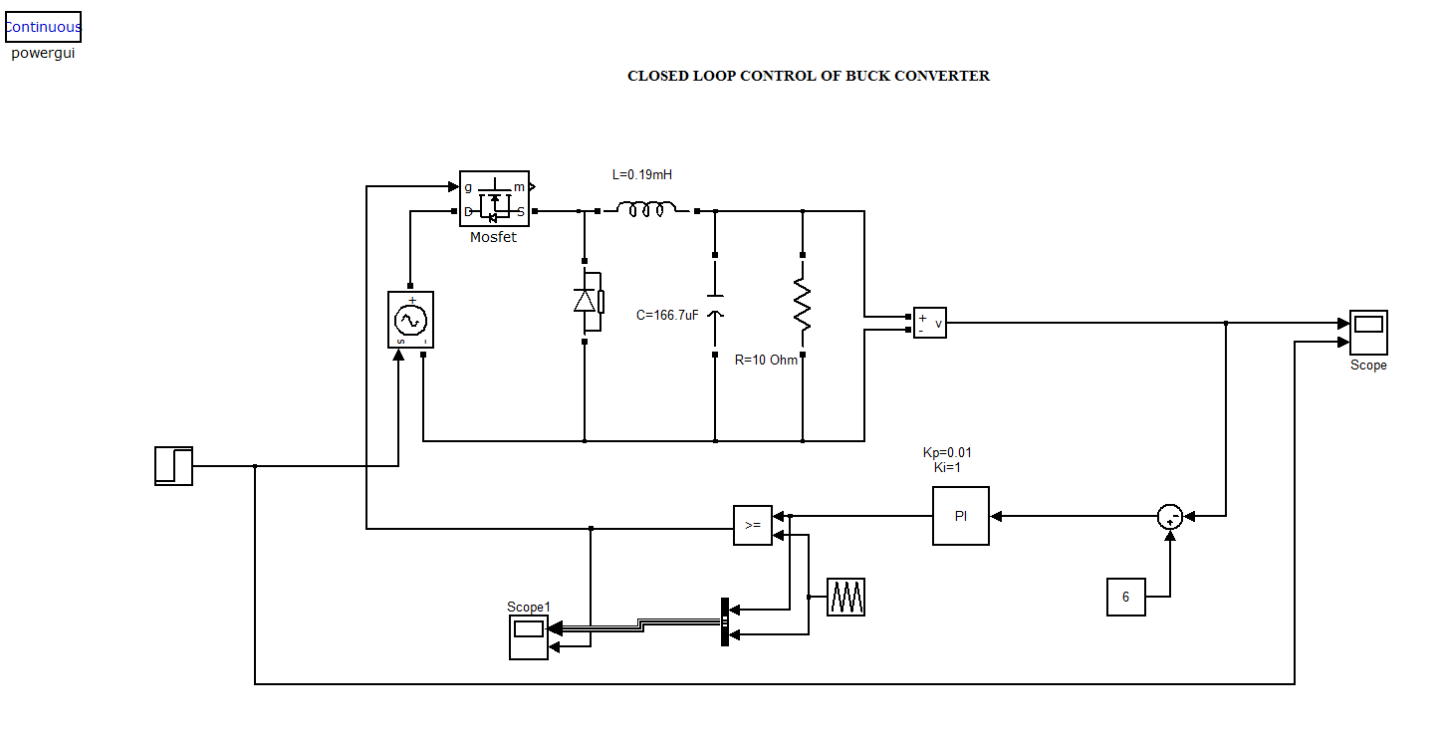
Closed loop control of Buck Converter with input voltage perturbations - line regulation

Slide 19
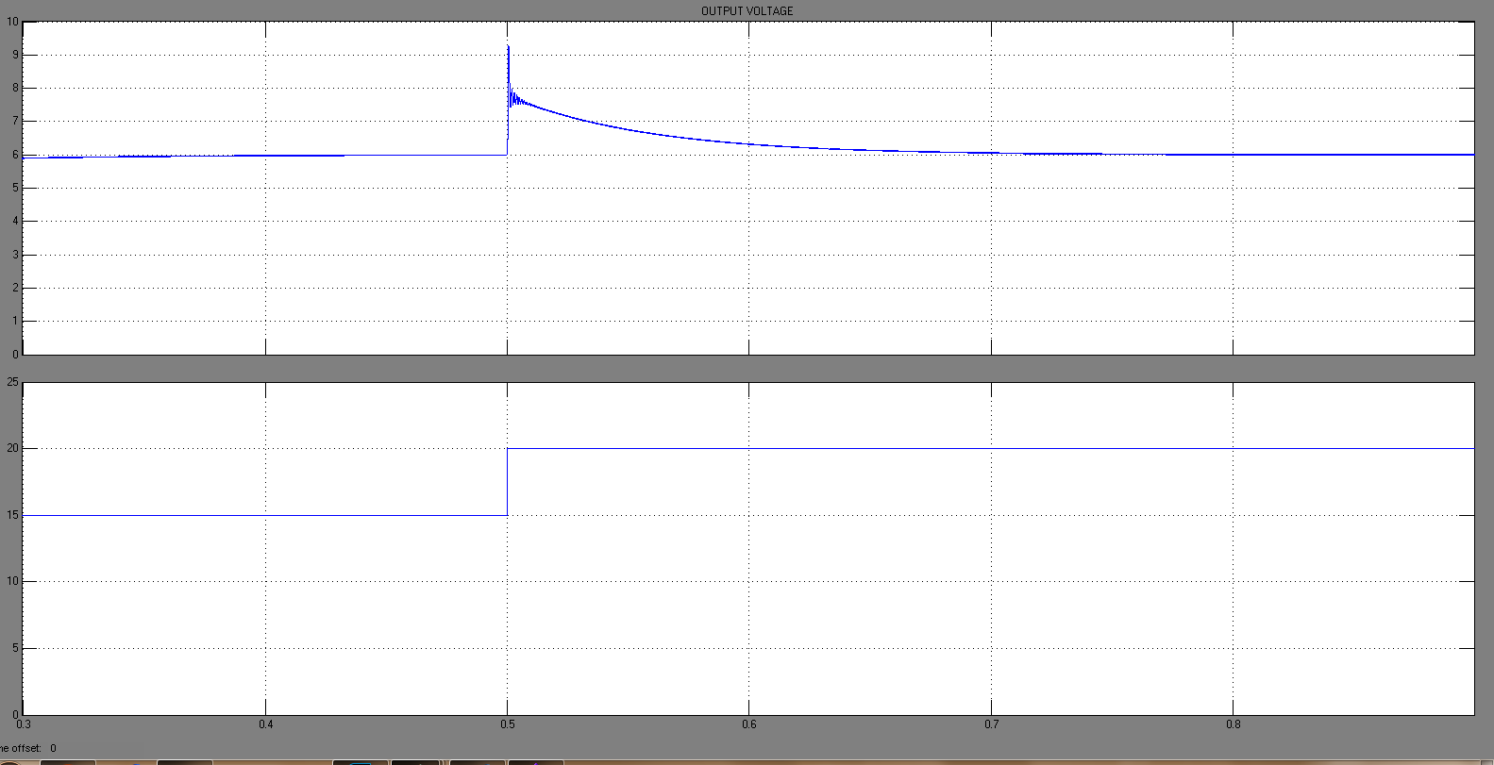
Closed loop control of Buck converter Input (changes form 14 V to 20V) and output voltage wave forms using PI controller

Slide 20
In PWM control, the duty ratio is modulated in a direction that reduces the error.
When the input voltage is perturbed, that must be sensed as an output voltage change and error produced in the output voltage is used to change the duty ratio to keep the output voltage to the reference value.
This means it has slow dynamic response in regulating the output in response to the change in input voltage.

Slide 21
One cycle control (OCC)
One cycle control
Non linear control technique.
Uses the concept of control of average value of switching variable.

Slide 22
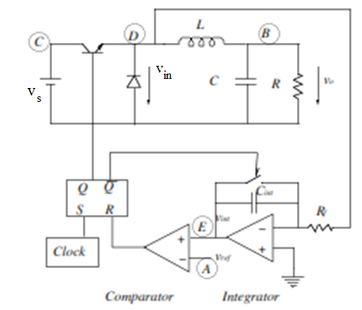
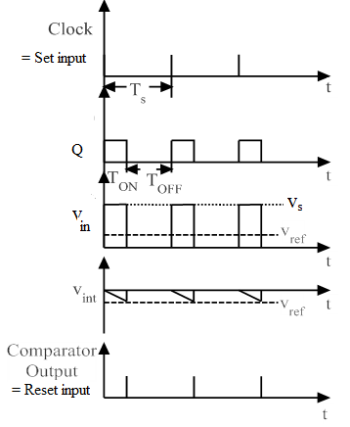
Buck converter using One Cycle control (OCC)
K. M. Smedley, “ Control Art of Switching Converters,”Ph.D. Thesis, California Institute of Technology, 1990.
Controls the duty ratio of switch such that the average value of switched variable is equal to or proportional to the control reference in each cycle
The output voltage of the buck converter is the average value of the switched variable v_{s}.

Slide 23
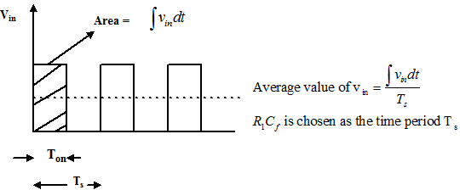
Buck converter using One Cycle control (cont.)

Slide 24
Power Source Perturbation Rejection
Here, the input perturbation will immediately cause a change in slope of the integration within one switching period. As a result duty ratio changes and output voltage do not change even if power a source having a disturbance.
Ie if input suddenly increases the slope of integrator output (= )
increases and it reaches the reference voltage V_{ref} early and ON period reduces and OFF period increases leading to reduction of duty ratio D

Slide 25
Change in Reference Voltage
When the control reference is perturbed by a large step up, the time taken to reach the new control reference increase (slope of integration remains the same since V_{in} is not changing)); therefore the duty ratio is larger. When the control reference is lower, the duty ratio is smaller.

Slide 26
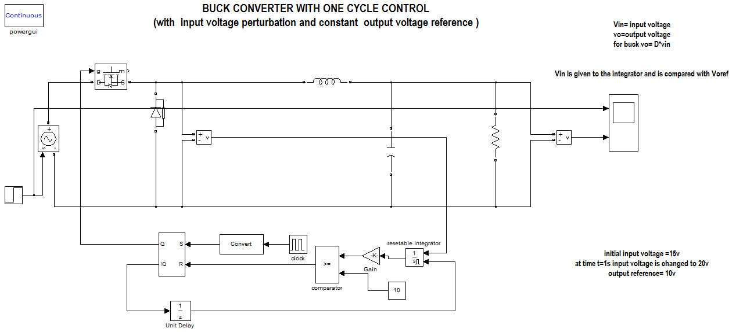
Buck converter with one cycle control
Clock frequency =10 kHz
Or Clock period = 0.1msec
K= 1/T_{s} = 10000

Slide 27
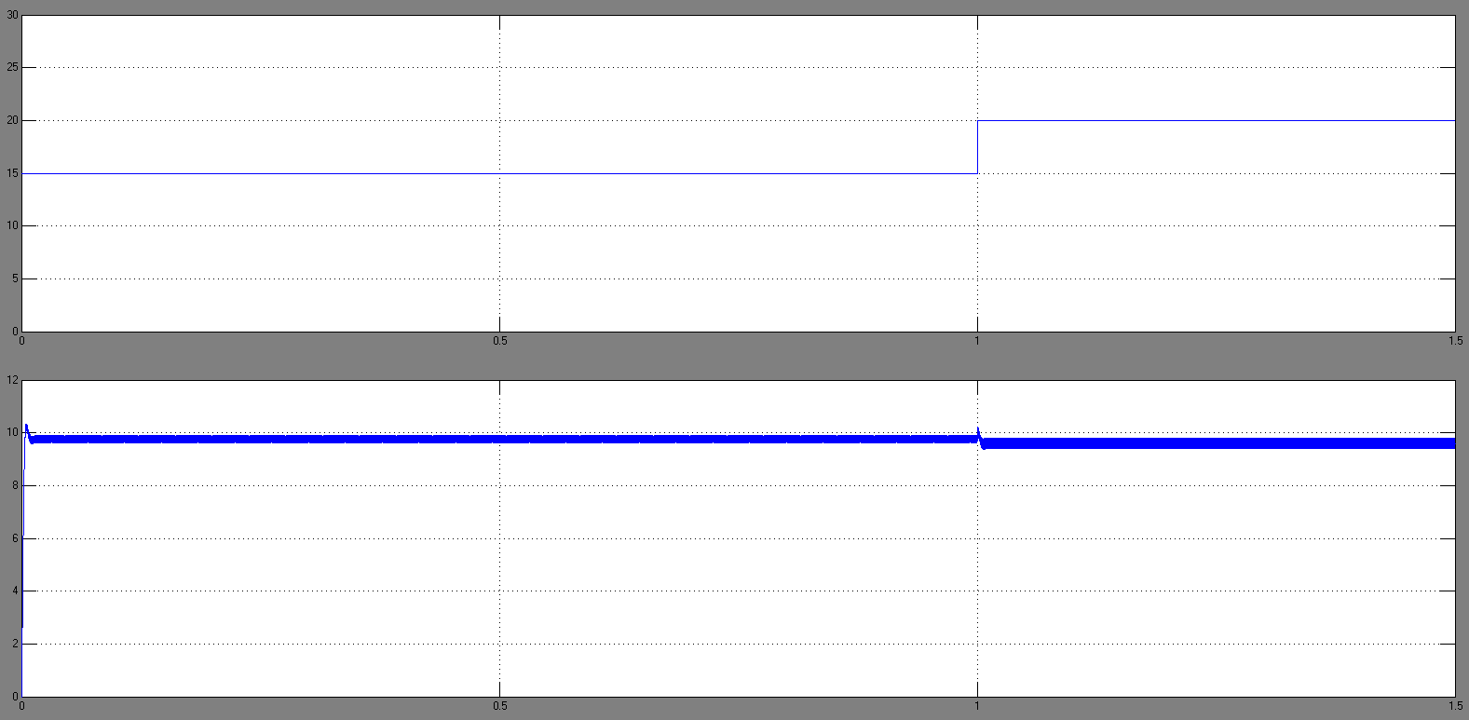
Buck converter with one cycle control (cont.) Input voltage and output voltage

Slide 28
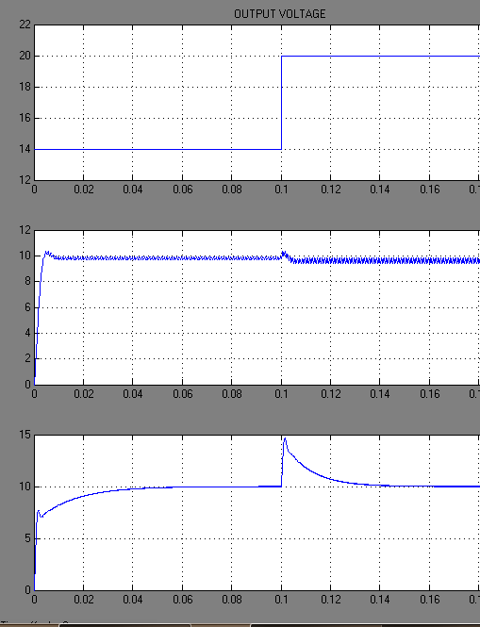
Performance comparison between OCC and PI during input voltage perturbation
a
b
c
(a)Input voltage perturbation (b) Output voltage using OCC (c) Output voltage using PI controller
c

Slide 29
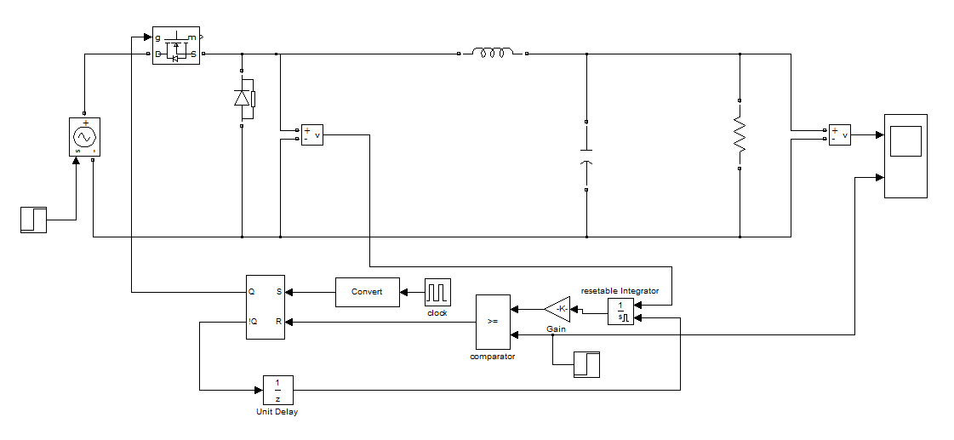
Buck converter using OCC with reference voltage perturbation

Slide 30
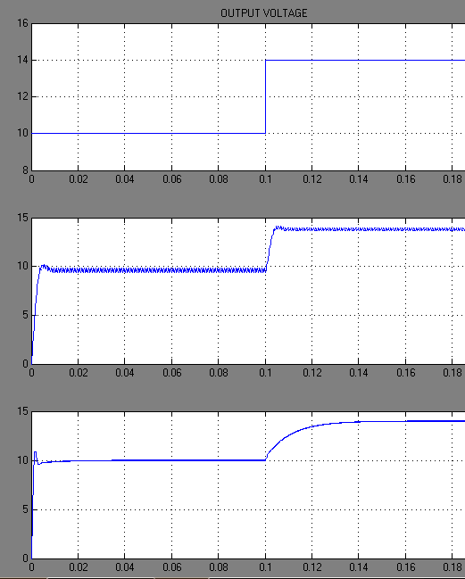
Performance comparison between OCC and PI during output voltage reference perturbation
a
b
c
(a)output reference perturbation (b) Output voltage using OCC (c) Output voltage using PI controller

Slide 31
Step-up (Boost) Converter

Slide 32
Volt-sec balance Boost converter

Slide 33
Volt-sec balance Boost converter (cont.)
Boost converter circuit while
the switch is position 1
Boost converter circuit while
the switch is position 2

Slide 34
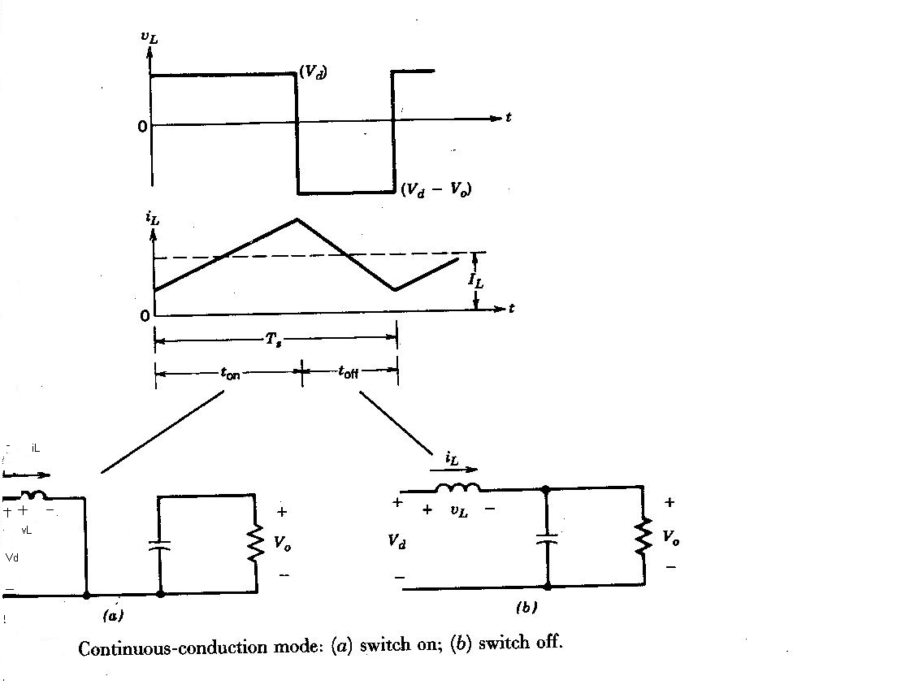
Boost Converter in Continuous Conduction Mode

Slide 35
Boost Converter in Continuous Conduction Mode
Inductor voltage in boost converter

Slide 36
Boost Converter in Continuous Conduction Mode (cont.)
In steady state the time integral of the inductor voltage over one time period must be zero
Assuming a lossless circuit, P_{d} = P_{o}
I_{o} is the average output current and I_{d} is the average input current
Hence in CCM step – up converter is equivalent to a dc transformer (step up)

Slide 37
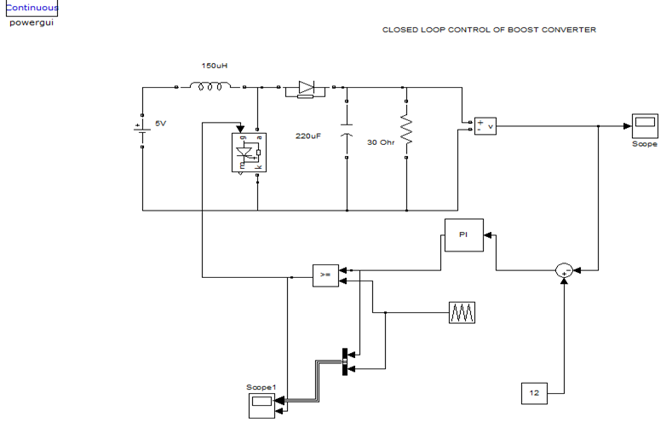
Closed Loop Control of Boost Converter

Slide 38
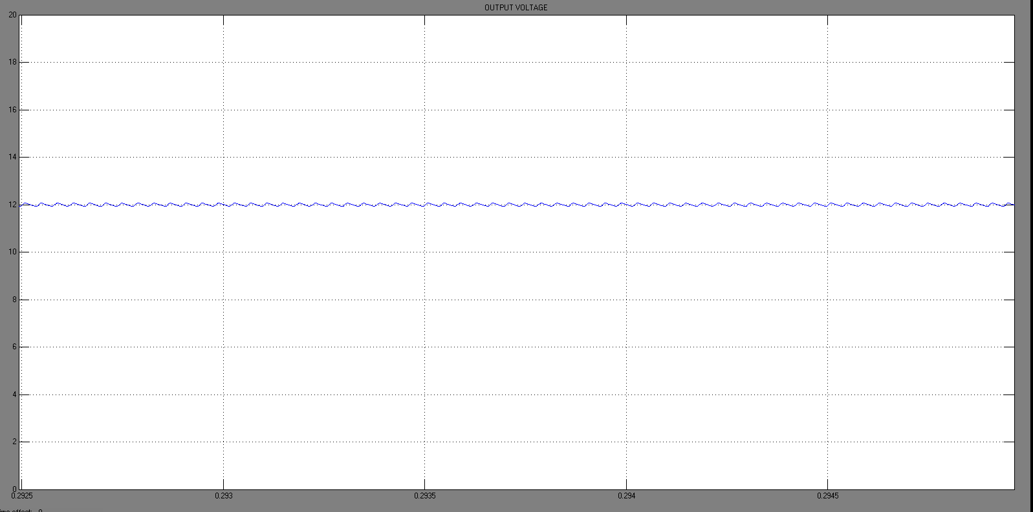

Slide 39
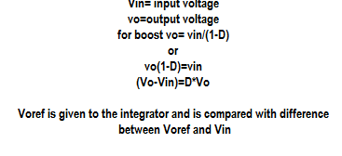
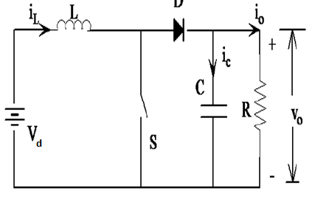
BOOST converter
In closed loop, output voltage V_{o} should be equal to reference voltage V_{ref},
Hence equation can be rewritten as $Vo=Vref=\frac{Vd}{1−D}$
$$Vref−Vd=\frac{1}{T_{S}}\int_{0}^{T_{ON}}{Vref.dt}$$
$Vref−Vd=Vref.D$

Slide 40
Simulation of Boost converter using OCC

Slide 41
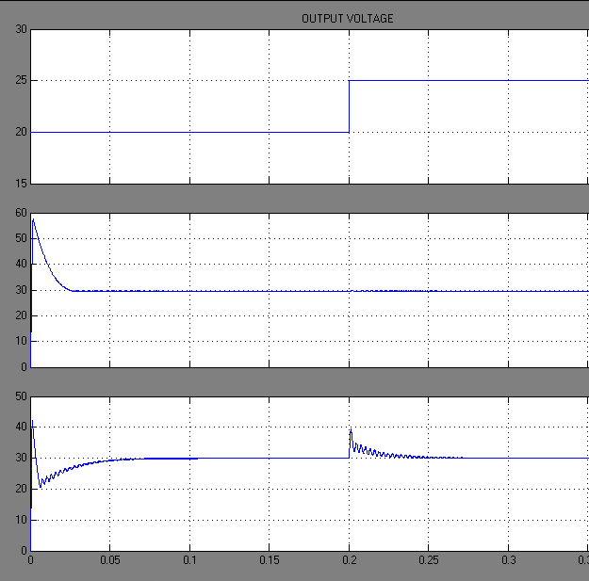
Performance comparison between OCC and PI during input voltage perturbation
a
b
c
(a)Input voltage perturbation (b) Output voltage using OCC (c) Output voltage using PI controller
c

Slide 42
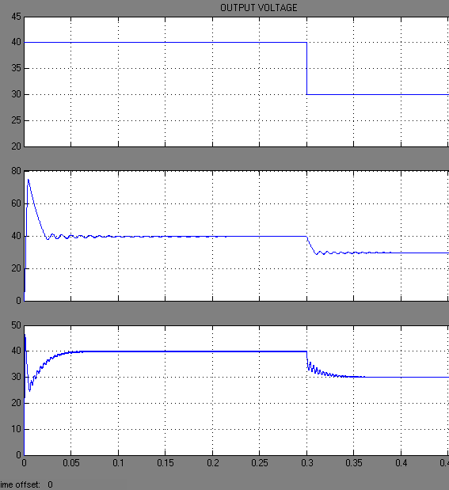
Performance comparison between OCC and PI during output voltage reference perturbation
a
b
c
(a)output reference perturbation (b) Output voltage using OCC (c) Output voltage using PI controller
c

Slide 43
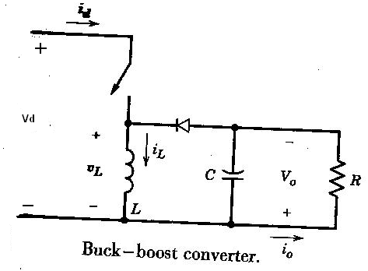
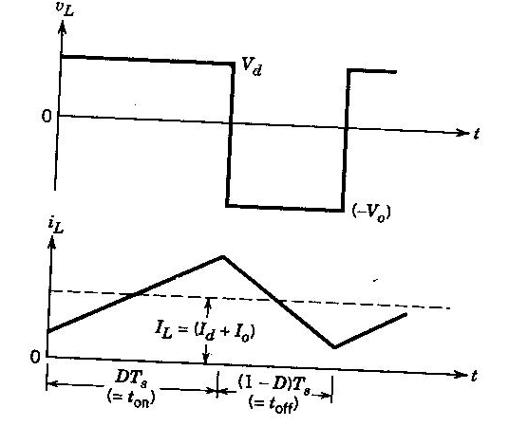
BUCK-BOOST Converter
$$Vref(1−D)=Vin.D$$
$Vref=\frac{1}{T_{S}}\int_{0}^{T_{ON}}{(Vin+Vref).dt}$

Slide 44
BUCK-BOOST Converter -OCC
In closed loop, the output voltage V_{o} should be equal to reference voltage V_{ref}
Hence by rewriting the equation,

Slide 45
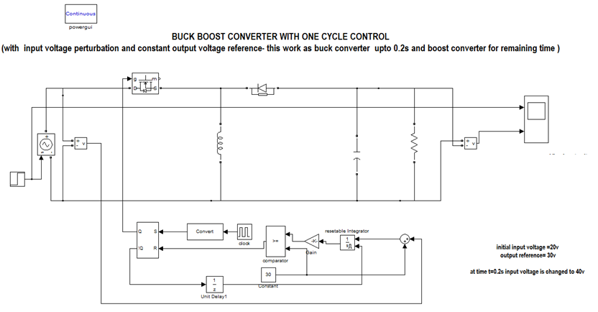
Closed loop control of Buck boost converter using OCC

Slide 46
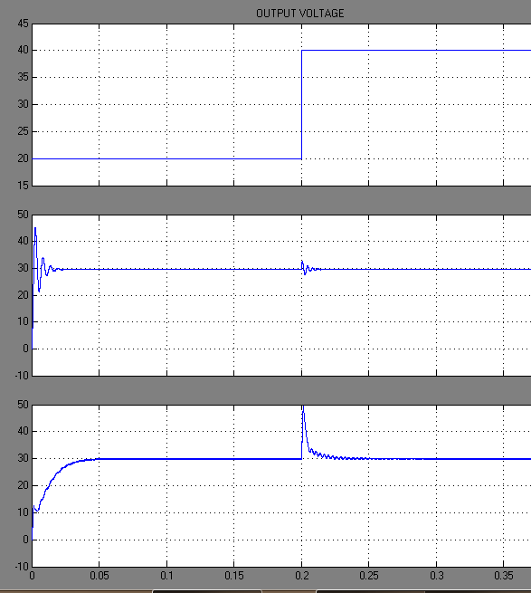
Performance comparison between OCC and PI during input voltage perturbation
a
b
c
(a)Input voltage perturbation (b) Output voltage using OCC (c) Output voltage using PI controller
c

Slide 47
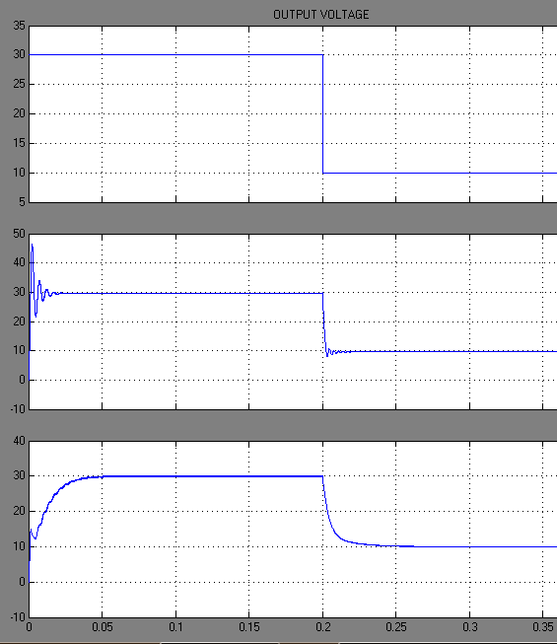
Performance comparison between OCC and PI during output voltage reference perturbation
a
b
c
(a)output reference perturbation (b) Output voltage using OCC (c) Output voltage using PI controller
c

Slide 48
OCC vs. PI
 |  | OCC | PI
Buck converter input voltage variation | Settling time | 6ms | 35ms
 | Maximum deviation from steady state | 0.8V | 4.2V
Buck converter reference voltage variation | Settling time | 4ms | 40ms
 | Maximum deviation from steady state | 0.5V | 0.2V
Boost converter input voltage variation | Settling time | 1ms | 50ms
 | Maximum deviation from steady state | 0.1V | 9V
Boost converter reference voltage variation | Settling time | 10ms | 25ms
 | Maximum deviation from steady state | 1V | 1V
Buck Boost converter input voltage variation | Settling time | 6ms | 25ms
 | Maximum deviation from steady state | 1V | 5V
Buck Boost converter reference voltage variation | Settling time | 4ms | 25ms
 | Maximum deviation from steady state | 2V | 2V

Slide 49
PI Vs. OCC :-Settling time performance
1:- buck input perturbation 2:- buck output reference perturbation
3:- boost input perturbation 4:- boost output reference perturbation
5:- buck boost input perturbation 6:- buck boost output reference perturbation

Slide 50
Conclusion
Compared to PI controller, OCC gives a better transient performance for DC-DC converter.
Less settling time
Less maximum deviation from steady state
Can find wide applications in drives and renewable energy sources.

Slide 51
Thank You

